Slide 1


2020 SVA Census Report Gender and Ethnicity
Compiled by
Student Veterans of America Research Department
Neo Pei
April, 2021

Slide 2
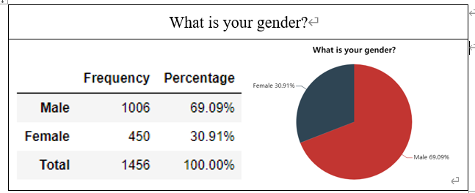
Gender

Slide 3
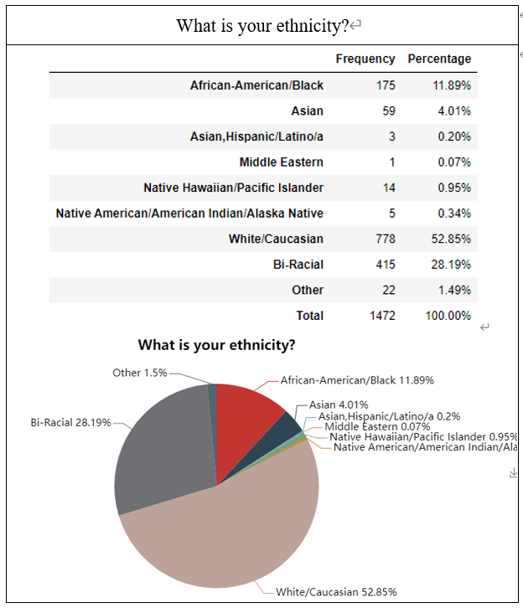
Echnicity

